Slide 1
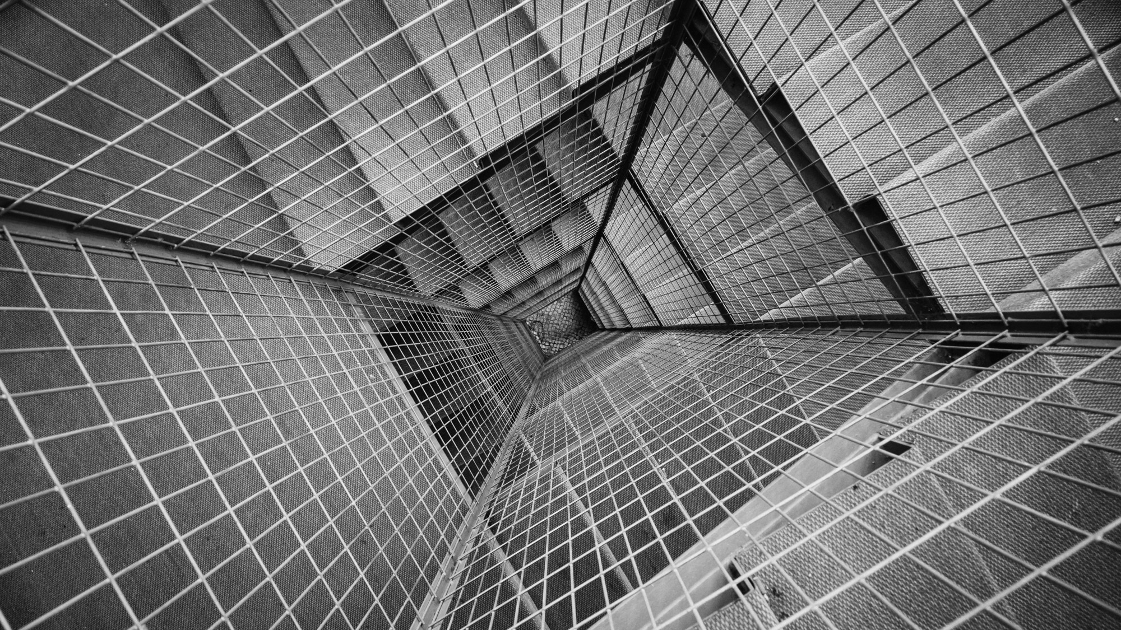
TOTAL TECHNOLOGY
REPORTLAB COMPLETE TUTORIAL
FRAME FLOWABLE
Part 23

Slide 2
WHAT IS FRAME:
Frames are active containers which are themselves contained in PageTemplates.
Frames have a location and size and maintain a concept of remaining drawable space.
Frames can be used directly with canvases and flowables to create documents.
The Frame.addFromList method handles the wrap & drawOn calls for you.
You don't need all of the Platypus machinery to get something useful into PDF.
TOTAL TECHNOLOGY

Slide 3
How to create Frames
#tutorial 23
#frames
from reportlab.platypus import Paragraph,Frame ,SimpleDocTemplate
from reportlab.pdfgen import canvas
from reportlab.lib.units import cm
from reportlab.lib.styles import getSampleStyleSheet
pdf=canvas.Canvas("tutorial23.pdf")
flow_obj=[]
frame=Frame(20,50,80,50,showBoundary=1)
frame.addFromList(flow_obj,pdf)
pdf.save()
TOTAL TECHNOLOGY

Slide 4
How to add text inside Frames
from reportlab.platypus import Paragraph,Frame ,SimpleDocTemplate
from reportlab.pdfgen import canvas
from reportlab.lib.units import cm
from reportlab.lib.styles import getSampleStyleSheet
pdf=canvas.Canvas("tutorial23.pdf")
flow_obj=[]
styles=getSampleStyleSheet()
text='''
this is frame
'''
p_text=Paragraph(text,style=styles["Normal"])
flow_obj.append(p_text)
frame=Frame(20,50,80,50,showBoundary=1)
frame.addFromList(flow_obj,pdf)
pdf.save()
TOTAL TECHNOLOGY

Slide 5
How to add text & image inside Frames
from reportlab.platypus import Paragraph,Frame ,SimpleDocTemplate
from reportlab.pdfgen import canvas
from reportlab.lib.units import cm
from reportlab.lib.styles import getSampleStyleSheet
pdf=canvas.Canvas("tutorial23.pdf")
pdf.drawImage("logo.jpg", 20,50, 80, 50)
flow_obj=[]
styles=getSampleStyleSheet()
text='''
this is frame
'''
p_text=Paragraph(text,style=styles["Normal"])
flow_obj.append(p_text)
frame=Frame(20,50,80,50,showBoundary=1)
frame.addFromList(flow_obj,pdf)
pdf.save()
TOTAL TECHNOLOGY

Slide 6
How to change frame boundary color & create multiple frames
from reportlab.platypus import Paragraph,Frame ,SimpleDocTemplate
from reportlab.pdfgen import canvas
from reportlab.lib.units import cm
from reportlab.lib.styles import getSampleStyleSheet
pdf=canvas.Canvas("tutorial23.pdf")
pdf.drawImage("logo.jpg", 20,50, 80, 50)
pdf.setStrokeColor("RED")
flow_obj=[]
styles=getSampleStyleSheet()
text='''
this is frame
'''
p_text=Paragraph(text,style=styles["Normal"])
flow_obj.append(p_text)
frame=Frame(20,50,80,50,showBoundary=1)
frame.addFromList(flow_obj,pdf)
pdf.drawImage("logo.jpg", 110,50, 80, 50)
flow_obj1=[]
flow_obj1.append(p_text)
frame=Frame(110,50,80,50,showBoundary=1)
frame.addFromList(flow_obj1,pdf)
pdf.save()
TOTAL TECHNOLOGY

